Slide 1





Community Partners

Slide 2
Applying Microservices principles to front-end
Ahmed Elharouny @harouny

Slide 3
Present
Frontend (SPA)
API Gateway
svc
svc
svc
svc
Notes:
Existing system that is using microservices architecture only on the backend.

Slide 4
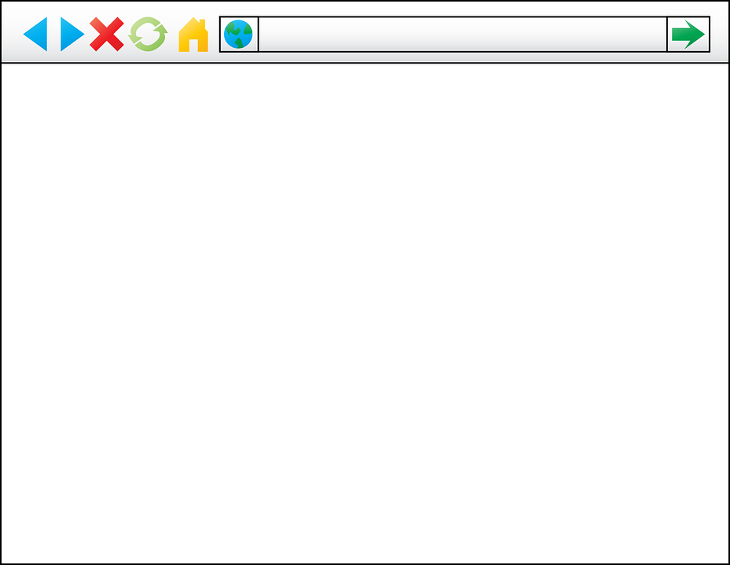
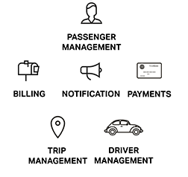
Present: Frontend
Notes:
Existing system that is using microservices architecture only on the backend.
Frondend is more complicated to work on, yet, don’t benefit from applying microservices principals that could reduce complexity

Slide 5
Future
API Gateway
svc
svc
svc
svc
APP
APP
APP
APP
Notes:
Our goal is to apply microservices principals on frontend. - Separately deployable components
- Isolated and decoupled
- Focused
- Technology agnostic

Slide 6
What we have learnt?

Slide 7











Reusable UI components
Notes:
Sharing css
Then sharing DOM components UI only
Then sharing css, UI and functionality
Then making component communication right
Then having all this in HTML standards

Slide 8
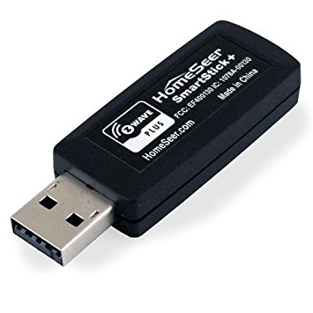
Reusable UI components
Simple interface

Slide 9

Reusable UI components
Composition reduces complexity

Slide 10
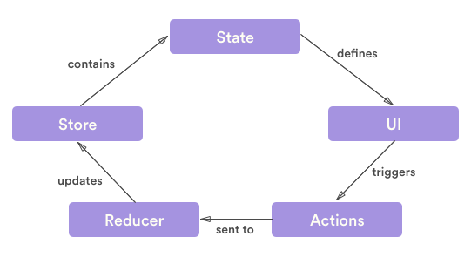
Reusable UI components
One flow on information

Slide 11
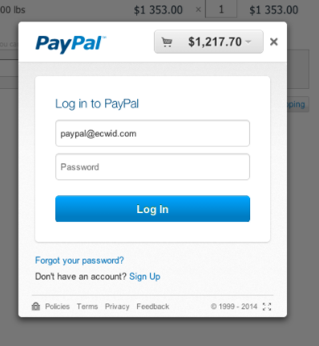
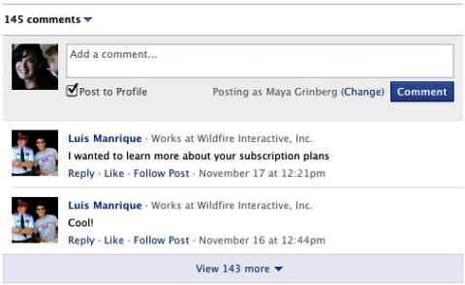
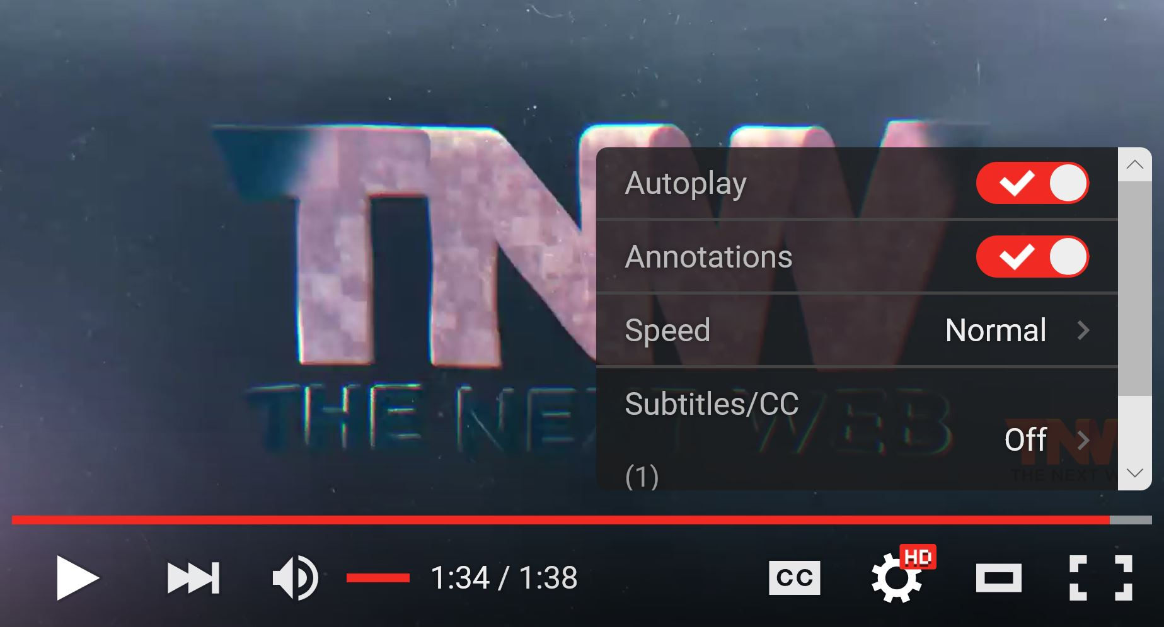
Cross domain components
Different domains
Different technologies
Different release cycles
Isolation
Ownership
Easy integration

Slide 12
Cross domain components constructs
<iframe>
window.open
window.postMessage

Slide 13
Cross domain components challenges
Iframes and popups
Too much static.
Difficult communication.
Doesn’t inherit styles.
Browsers behaving very differently, i.e. popups open in a full page.
Slower to load.
window.postMessage
Browsers behaving differently, i.e. IE 11 < will prevent window-to-window.
Fire and forget.
One huge event handler where all messages are delivered.
Difficult to secure communication.

Slide 14
window.postMessage
https://www.mysite.com
window.parent.postMessage(‘Get user token’, ‘*’);
https://product.mysite.com

Slide 15
window.postMessage
https://www.mysite.com
window.parent.postMessage(‘Get user token’, ‘*’);
message.source.postMessage(‘User token: XYZ’, *);
https://product.mysite.com

Slide 16
window.postMessage
https://www.mysite.com
window.parent.postMessage(‘Send user token’, ‘*’);
window.parent.postMessage(‘Get user token’, ‘*’);
https://www.hacker-site.com
https://product.mysite.com

Slide 17
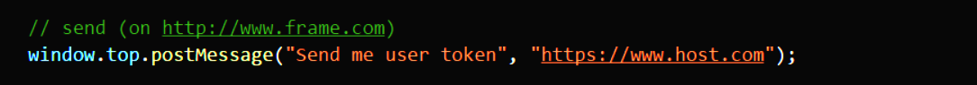
window.postMessage
Safely allow cross-origin communication between different pages.

Slide 18
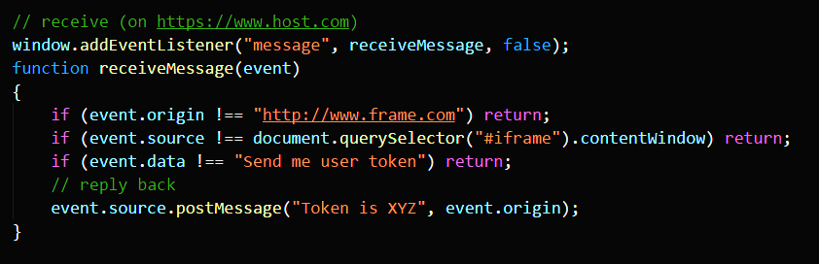
window.postMessage
Safely allow cross-origin communication between different pages.

Slide 19
What can we do based on what we have learnt?

Slide 20


Abstract rendering into:
Iframe
Window
Provides a simple component-like contract.
Supporting passing properties down, actions up.
Securely handle communication.
Technology specific adapters.

Slide 21
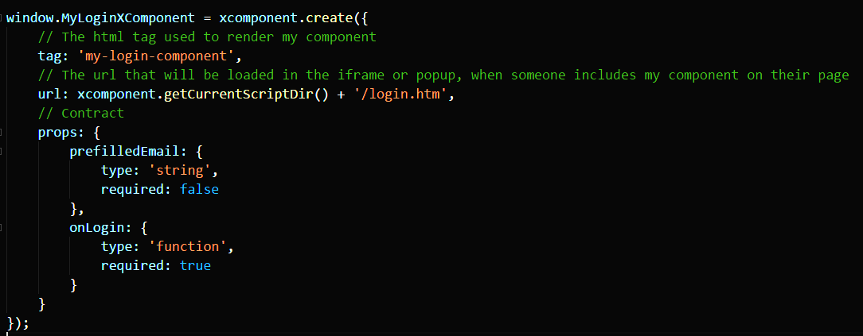
Step 1: Declare component
Notes:
Reference: https://developer.paypal.com/docs/integration/direct/express-checkout/integration-jsv4/client-side-REST-integration/

Slide 22
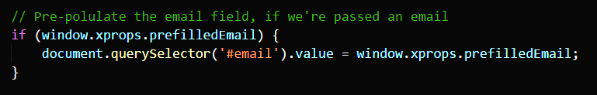
Step 2: Capture props
Notes:
Reference: https://developer.paypal.com/docs/integration/direct/express-checkout/integration-jsv4/client-side-REST-integration/

Slide 23
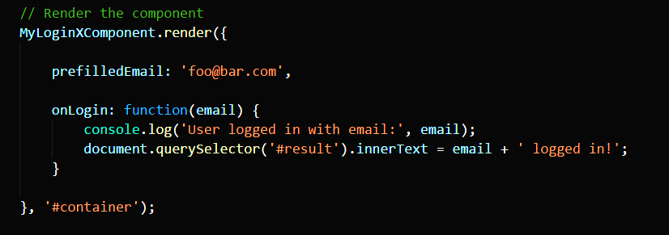
Step 3: Render component on host side
Notes:
Reference: https://developer.paypal.com/docs/integration/direct/express-checkout/integration-jsv4/client-side-REST-integration/

Slide 24
Demo – Hello World Xcomponent
https://github.com/harouny/luxor

Slide 25
Communication theory
One flow of data
Host pass down props.
Component bubble up events.
Component subscribe to props change to update internal state.
Updating component internal state trigger UI changes.
Host can update props based on events.

Slide 26
One flow of data
On Props
On event
Set Props
On Props
Raise event
Set Props
Raise event
On event
Host
Component

Slide 27
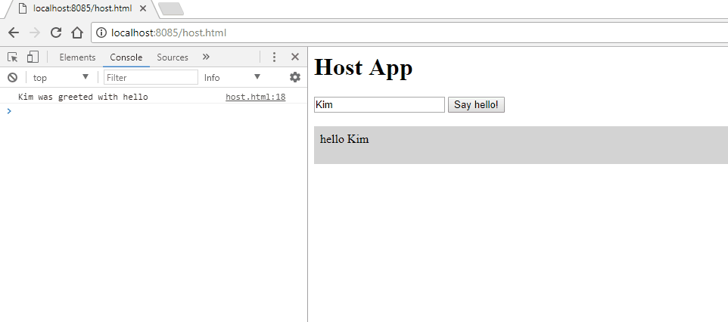
Demo: One flow of data

Slide 28
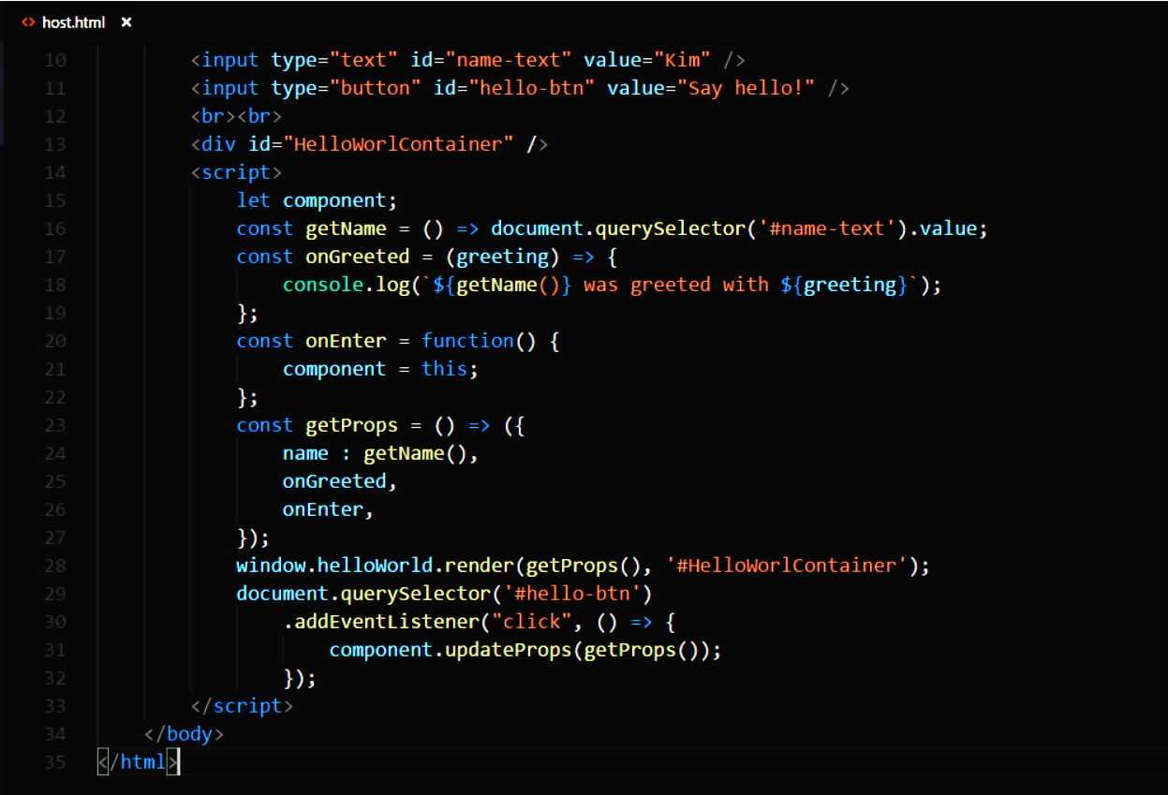
2
1
3

Slide 29
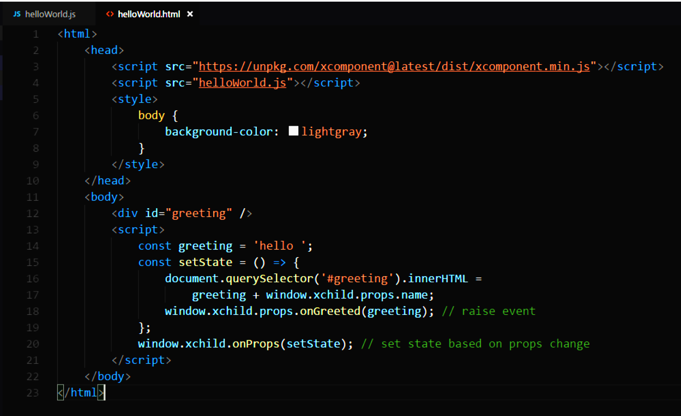
2
3
1

Slide 30
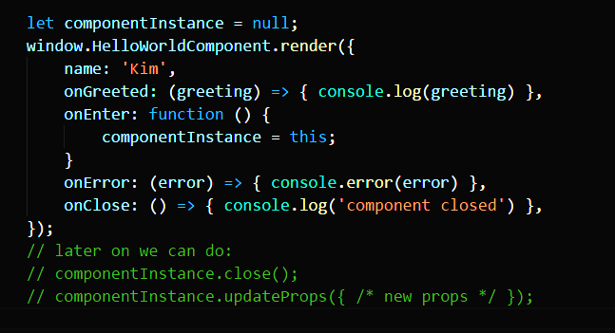
Lifecycle hooks

Slide 31
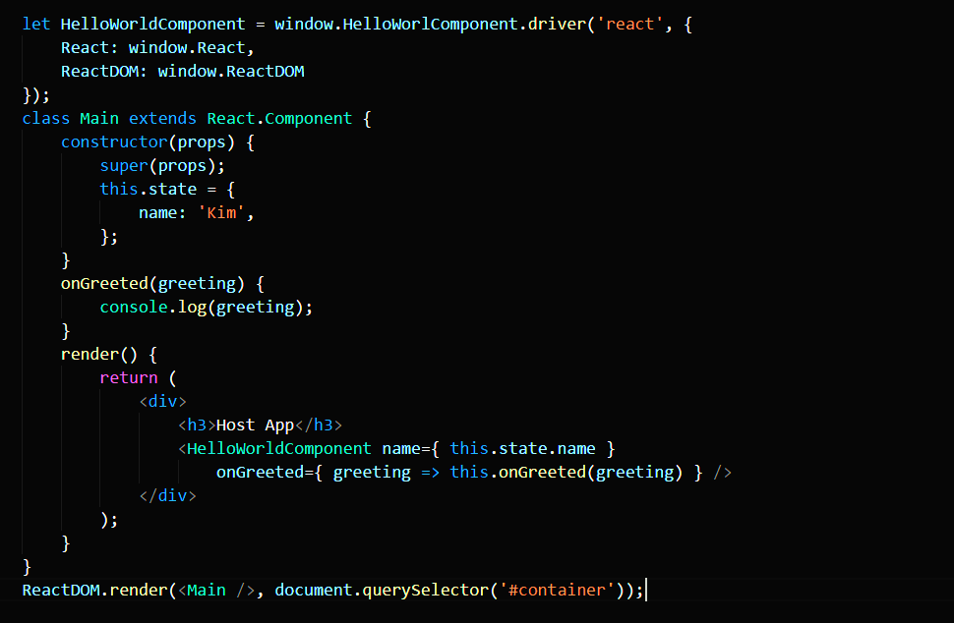
Framework drivers

Slide 32
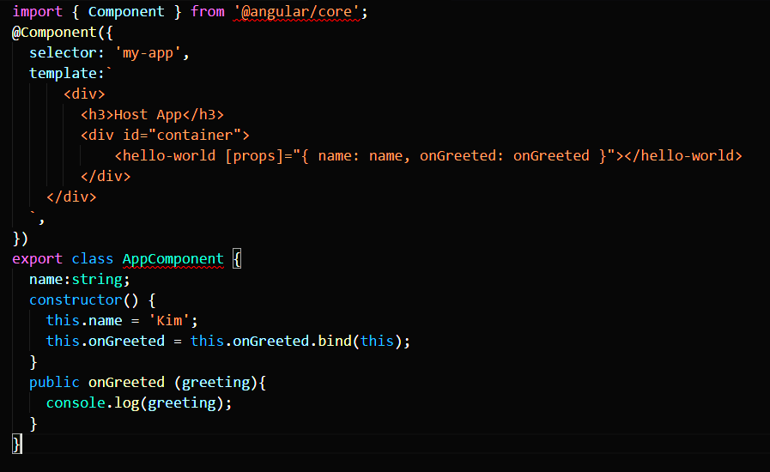
Framework drivers

Slide 33

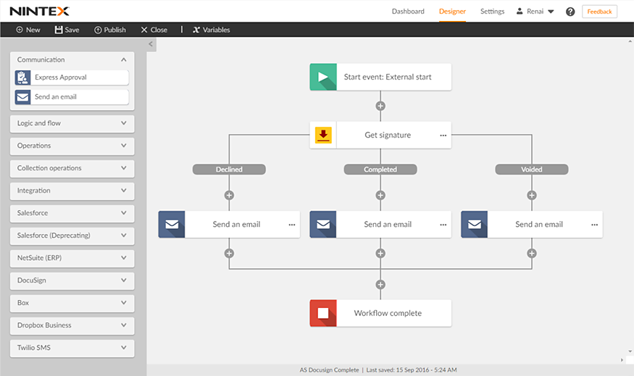

Slide 34
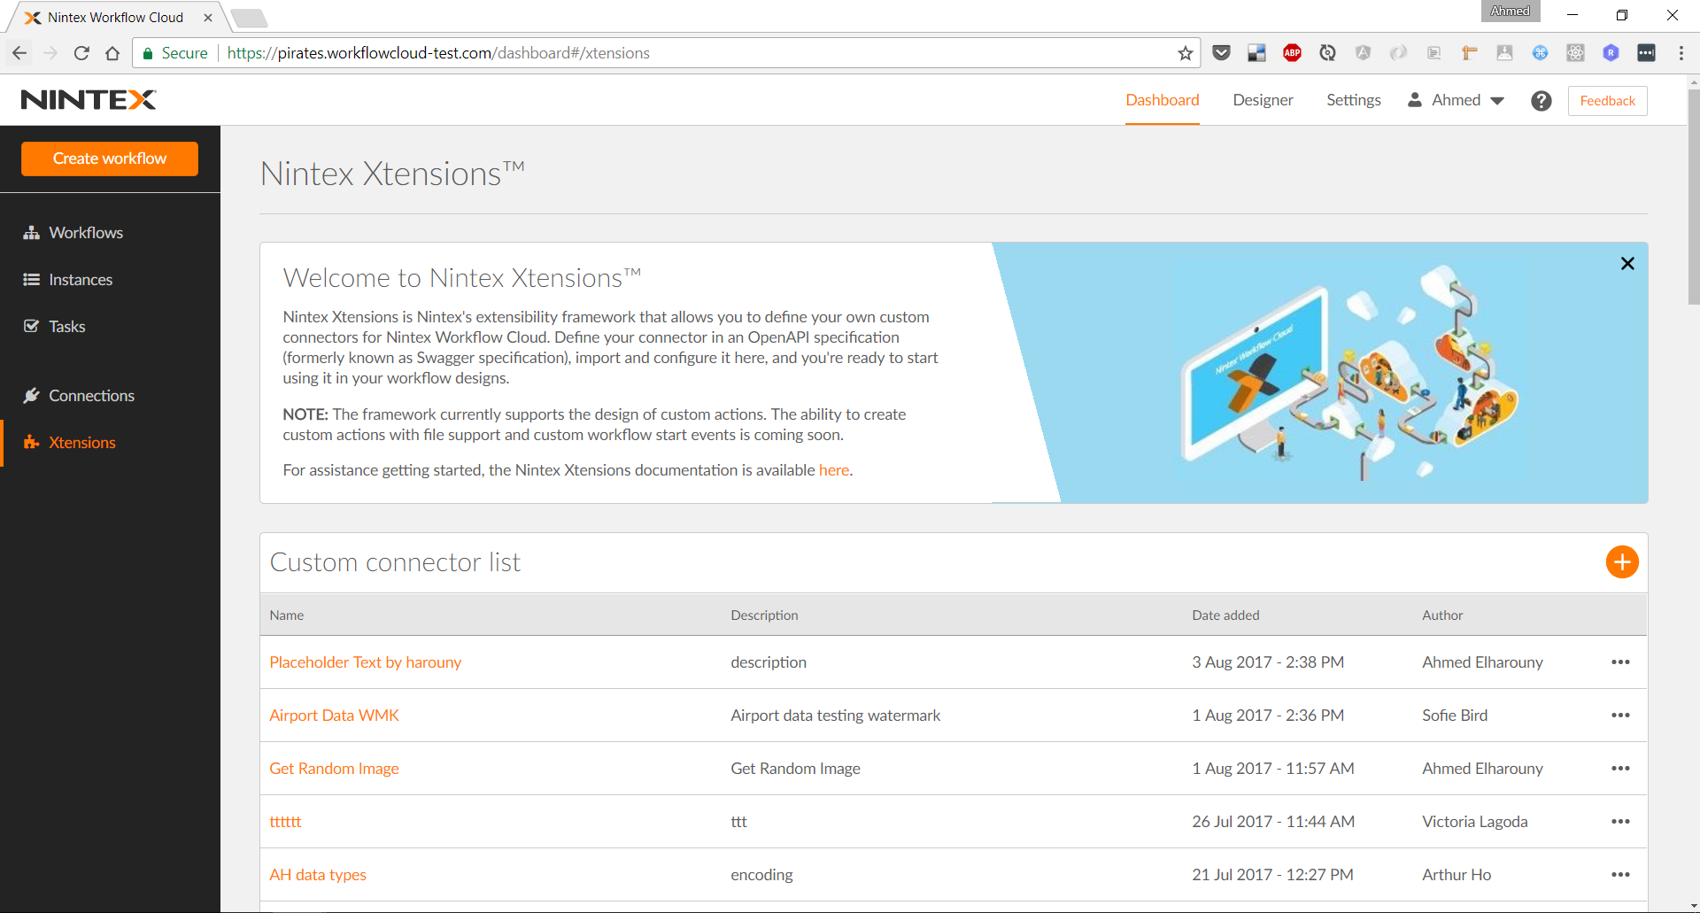

Slide 35
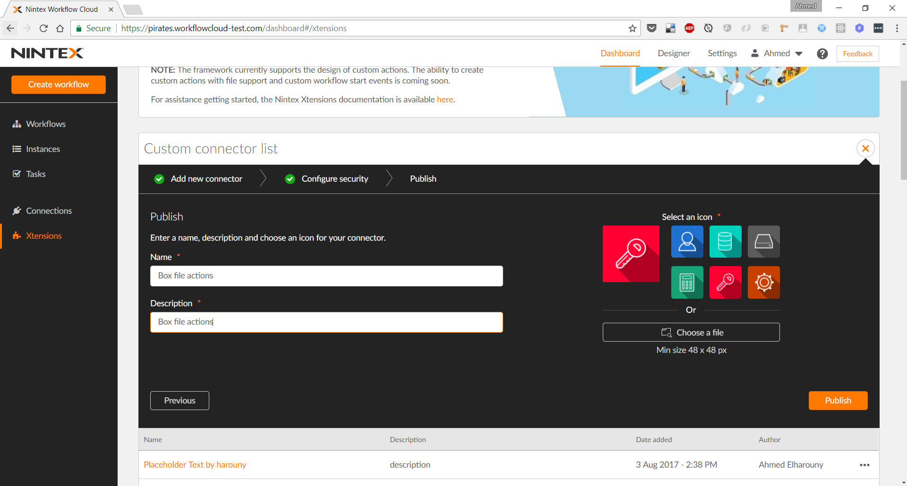

Slide 37
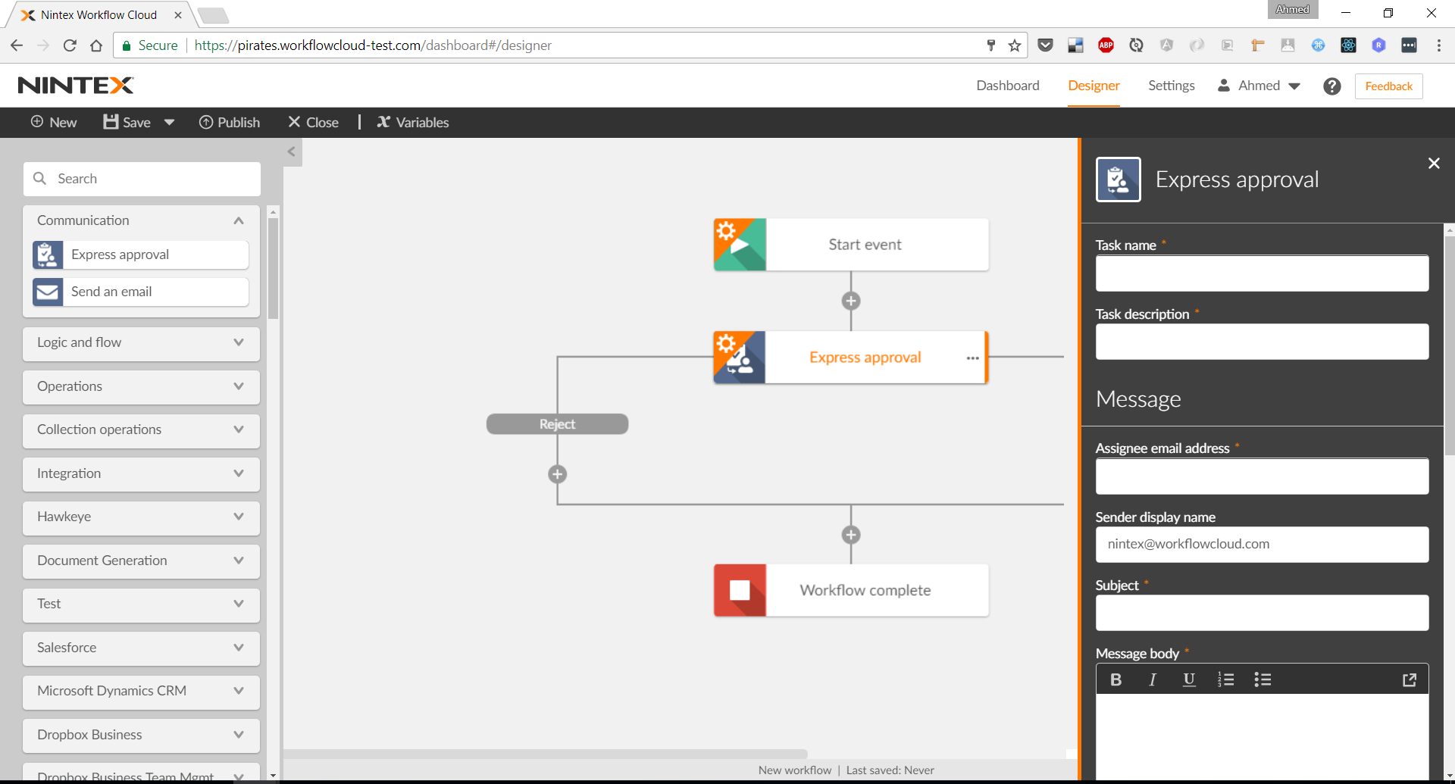

Slide 39
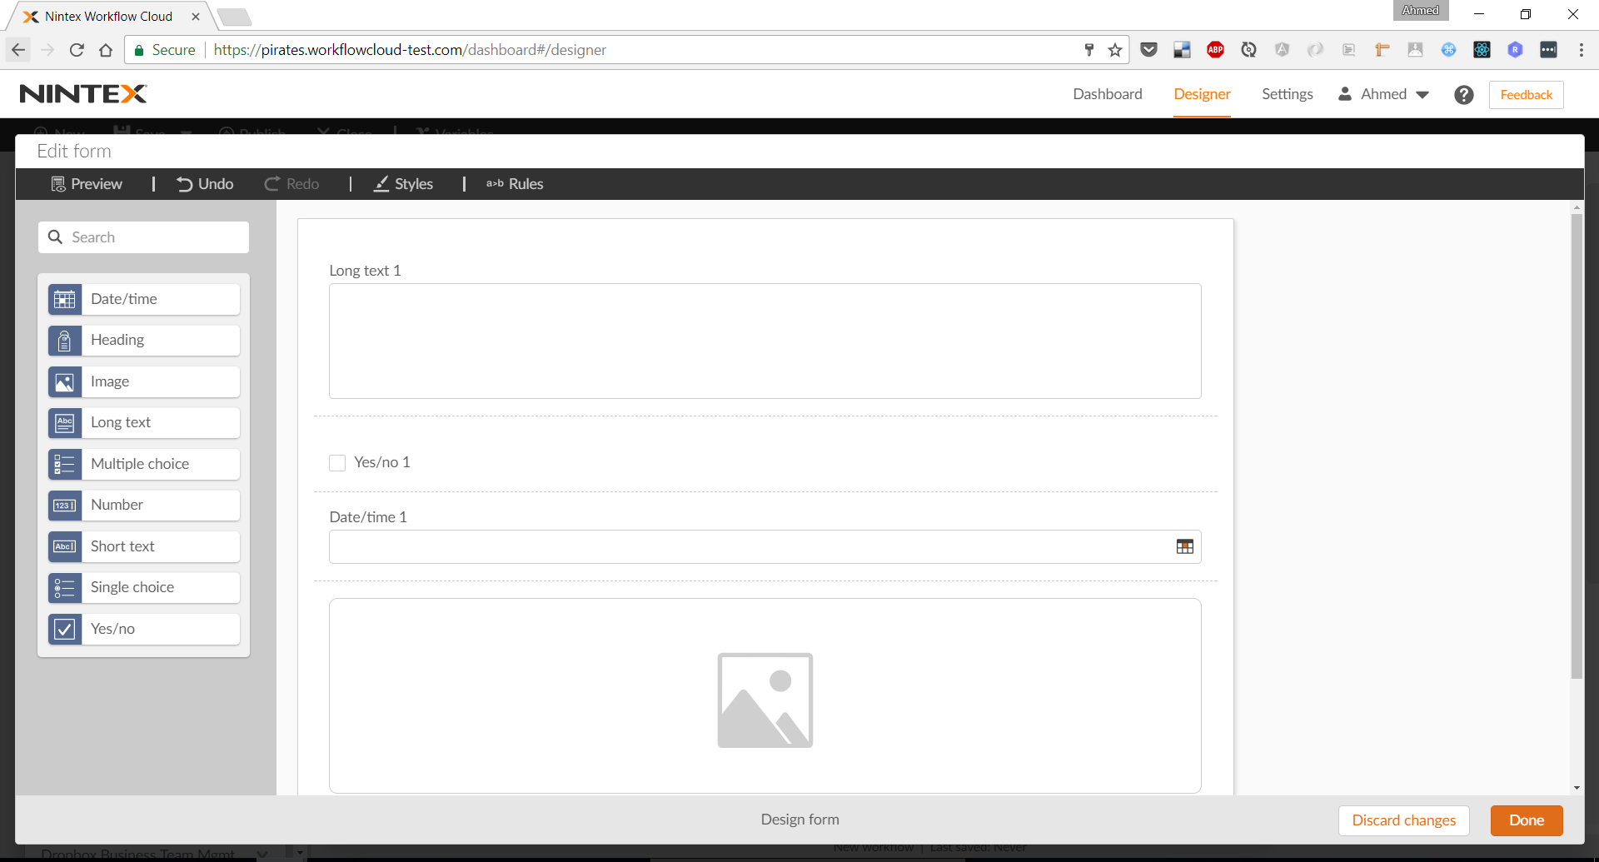

Slide 41
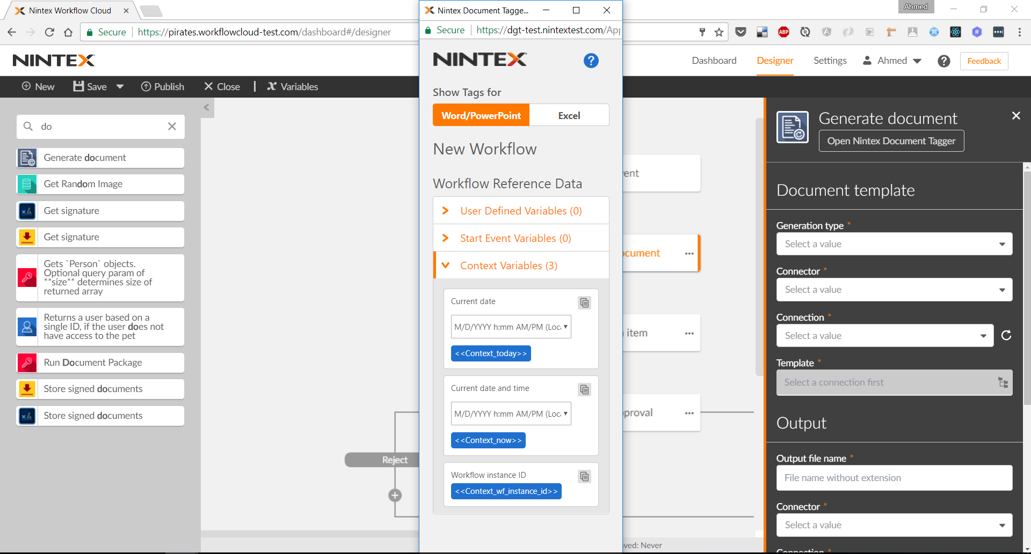

Slide 42
Be aware of …
Xcomponent is not meant to replace native components.
Use it to share complete functionality.
Keeps contract simple.

Slide 43
Be aware of …
Bundle Xcomponent library with component definition in one script.
Simple integration.
Use Webpack for bundling.

Slide 44
Be aware of …
Angular digest cycle, change detection.
Event handlers (functions) are executed outside of angular context.
Native drivers helps to avoid the problem.

Slide 45
Be aware of …
Xcomponent uses some built-in props.
onEnter
onRender
onClose
LogLevel

Slide 46
Be aware of …
“this” in event handlers (functions).
Bound to component instance even if you don’t think so, i.e. inside a class.

Slide 47
Be aware of …
IE < 11 prevent communication with popups in a different domain.
Iframe bridge is required (configuration)

Slide 48
Conclusion
Xcomponent brings the best of both worlds of:
Native components
Simple contract
Communication style
Cross domain components
Isolation
Flexibility
Technology independence

Slide 49
Q & A

Slide 50
















